Slide 1
COMP23420 sem2 week 4:
GRASP design principles (1)
John Sargeant (johns@cs.man.ac.uk)
Notes:
Title slide

Slide 2
Agile teamworking: reminder
AM: Individuals and interactions over processes and tools
Reminder: good teamworking == good communication
Every team member should learn from every other team member
Self-improving teams – in each iteration you should aim to work together better than in the last
Specific practice: retrospectives. A physical meeting at the end of each iteration to decide what to do differently in the next.

Slide 3
Aspects of SE
Building the right software
Building the software right
Most of the course so far has been about 1. Now we will focus on 2.

Slide 4
Refactoring
Most non-trivial SW systems end up as Big Balls of Mud – see http://www.laputan.org/mud/
OO techniques help, up to a point, but don’t solve the problem
Subsystems interact in unpredictable ways
A design which looks good initially may be unsuitable later.
Refactoring – changing the code purely to improve the design – is vital.
Never refactor and add/change functionality at the same time.

Slide 5
Red-Green-Refactor
An agile way of working (a form of TDD): Should be done with a small amount of code in one cycle.
Red: write tests. These will fail, because you haven’t written the code to be tested yet.
Green: Write the application code in the simplest way feasible.
Refactor: restructure and improve the code.
Recommendation: try this out in the lab, but don’t stick with it unless it works for your team.

Slide 6
GRASP
How do we know what’s a good design?
Only by experience, but much of that experience has been codified as Patterns.
GRASP = General Responsibility Assignment Software Patterns
A set of principles for assigning responsibilities to classes – the key skill in OO software design (observation: even strong programmers are often weak designers)
GRASP provides the “building blocks” for Design Patterns (COMP33411)

Slide 7
Case study
You have been hired to develop an integrated information system for the Irwell online store. They originated as a book store but now sell other forms of media such as CDs and DVDs. They also intend to branch out into selling electronic devices such as laptops and PDAs although they don’t intend to become a general store.
Initially you will develop an inventory system: an inventory lists the products a company has in stock, along with information such as prices.

Slide 8

A possible design

Slide 9
Cohesion and coupling
The most fundamental design principles of all
High Cohesion: a class must represent a single well-defined entity
Low coupling: minimise dependencies between classes
NB: coupling is not just the number of connections between classes – how complex those connections are is also important
The Inventory system class has very poor cohesion – it represents at least three different entities.

Slide 10
Types of coupling
Internal coupling – between classes within a subsystem
External coupling – between the subsystem and the rest of the system
The naïve design has high (i.e. bad) external coupling, a “bloated interface”.

Slide 11
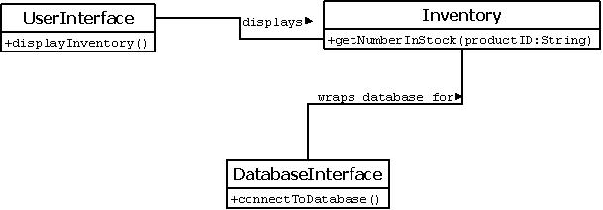
Slightly better

Slide 12
Improvements
Much better cohesion, each class is at least all one kind of thing.
The UI is separated from the business logic – model-view separation.
External coupling is reduced, e.g. code dealing with the inventory is not coupled to the UI.
The UI and the Inventory, (and maybe the database interface) need to be decomposed further.
UIs should be divided into small components each with a well-defined role. Avoid huge constructors and GridBagLayouts.

Slide 13
Pure fabrication
A Pure fabrication is a design class which does not correspond to anything in the domain, e.g.
Collections
Interfaces to external systems, e.g. database connectors
Factories – classes whose sole job is to create objects of other classes.
UI components
Indirections to, and abstractions of, other classes.
Over time, the PFs usually outnumber the domain-inspired classes.

Slide 14
Decomposing the Inventory
A possible implementation has three lists, of products, prices, and numbers in stock.
These have to be kept consistent.
When this happens, it usually means we are missing something.
In this case a line item, a (product, price, number) combination.
Also, we should represent products as instances of a Product class.

Slide 15
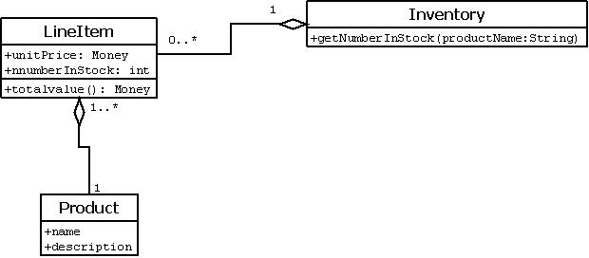
A workable design

Slide 16
Why a separate Product class?
We could have product information as part of the LineItem class, but
Product is a logically separate concept – make it separate for this reason alone.
It could appear in other parts of the application
We can change the product implementation without affecting LineItem
We may want to have different kinds of product – see next week.

Slide 17
Information Expert
GRASP principle – put a responsibility in the class which has the information to carry out that responsibility. (Often abbreviated to Expert)
E.g. getTotalValue is in LineItem as it has the unit price and number-in-stock information.
c.f. Don’t talk to strangers – avoid long chains of thing().thing().thing()….
Converse – put the information needed for an operation in the class where that operation naturally fits.

Slide 18
To think about
How could the LineItem class be reused elsewhere in the application?
What does the multiplicity: Product 1 -> 1..* LineItem mean? (Hint when considering multiplicities always look at both ends, so this question has two answers)
Why is the unit price information in LineItem rather than Product?
What information in the case study have we yet to take account of?
How could your design for iteration 1 be improved in terms of coupling and cohesion?

Slide 19
Questions?

